Slide 1
Customer Transactions EDA & Insights
By: Curisia Allen
Tools Used: Excel (Data Cleaning and Transformation), Tableau (Visualizations), SQL (Queries)

Slide 2
Business Problem
The goal of this analysis is to identify the key customer, product, and time-based factors that most strongly influence customer spending at the fast-food chain. By understanding how variables such as gender, order type, time of day, and product preferences affect spending behavior, the company can better target marketing efforts, improve menu strategy, and increase revenue.

Slide 3
Data Overview
This dataset was found on Kaggle: Restaurant Sales report
To prepare the dataset for analysis, I performed several cleaning and transformation steps:
Standardized the gender field: The dataset originally used titles (“Mr.”, “Ms.”, “Mrs.”) instead of gender labels. I mapped “Mr.” to Male and “Ms.”/“Mrs.” to Female for consistency.
Extracted date components: The original date field (“mm/dd/yyyy”) was split into Year, Month, and Day of Week. The day of week was initially represented as numbers (0–6), so I converted these values into their corresponding names (Sunday–Saturday).
Handled missing values in transaction type: A few entries in the Transaction Type column were null. Instead of leaving them blank or forcing them into existing categories (e.g., cash or online), I created a separate category and labeled them as “Gift Card” to preserve information.
Ensured correct data types: “Item Price” and “Transaction Amount” were converted to currency, and Quantity was enforced as a whole number.
Added a calculated Profit column: Since cost data wasn’t provided, I applied a simple assumption that operational costs account for 30% of revenue, and calculated Profit = 0.7 × Transaction Amount. This allowed for basic profitability insights without introducing unrealistic assumptions.

Slide 4
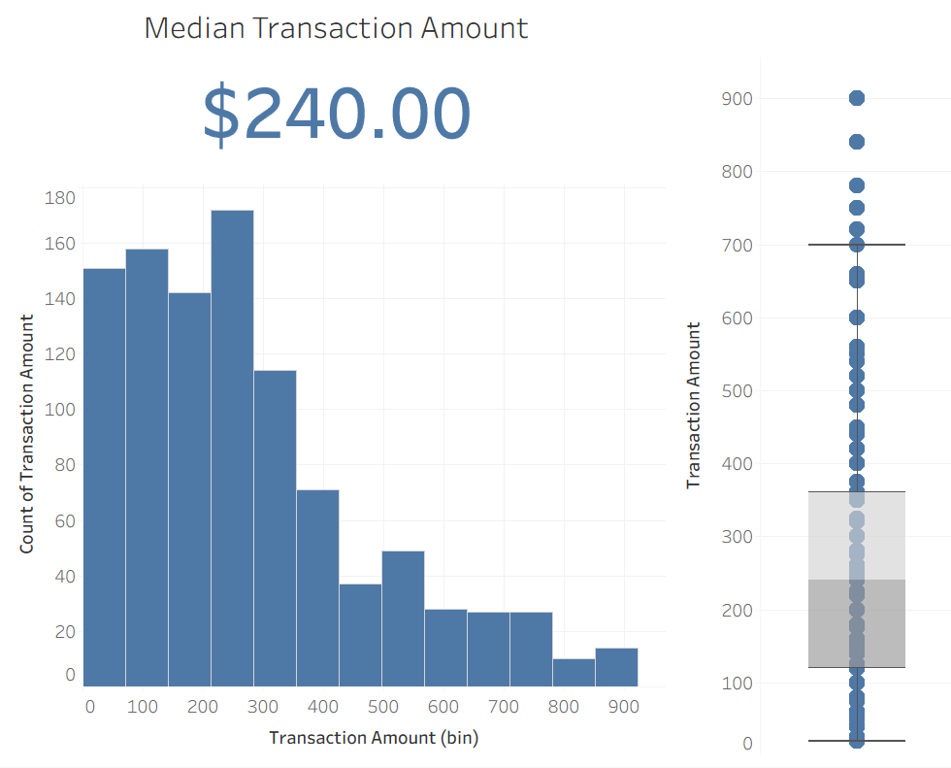
Understanding Overall Customer Spending Patterns
Insights:
The median transaction amount is $240, indicating a typical customer spends around this value per visit.
Spending distribution is right-skewed: most transactions fall between $100–$300, with a small number of high-value outliers reaching $900+.
Outliers suggest occasional bulk purchases or large group orders — opportunities for targeted upsell or loyalty programs.

Slide 5
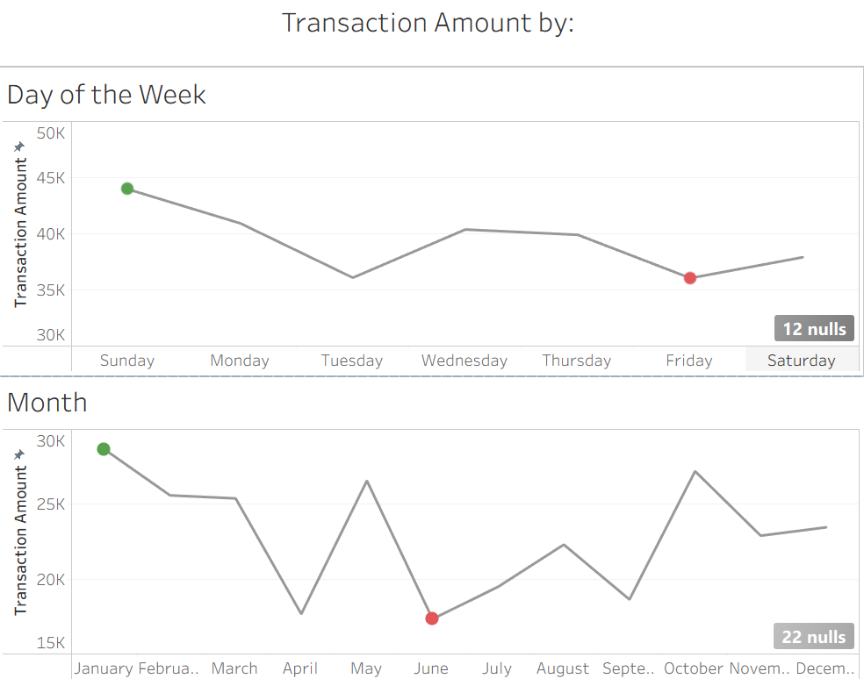
Identifying High-Traffic Days and Seasonal Trends
Insights:
Saturday and Sunday are two of the highest revenue, showing strong weekend performance that could support extended hours.
Friday is the lowest-performing day, potentially costing more in labor/utilities than it brings in — a clear opportunity for cost-saving or targeted promotions.
Monthly patterns show peaks in January, May, and October, possibly linked to seasonal events or customer patterns that can be capitalized on.

Slide 6
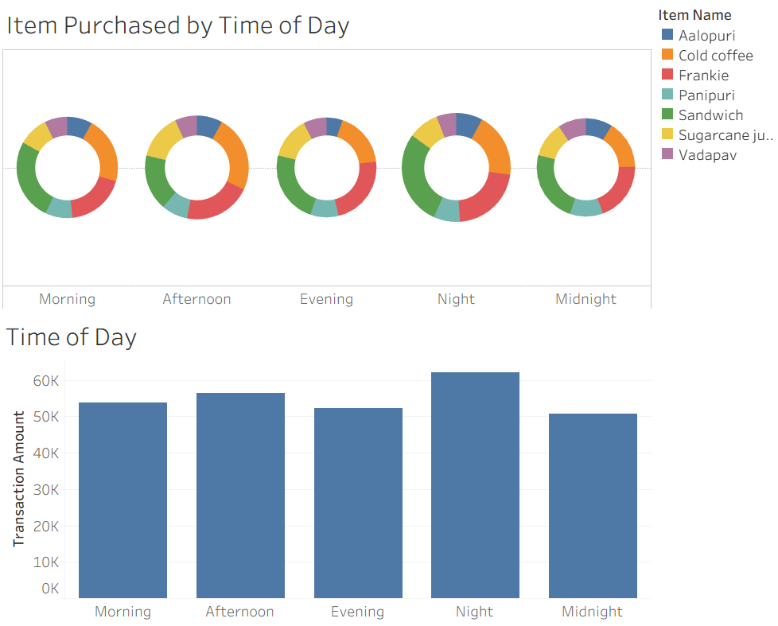
How Time of Day Influences Sales and Item Mix
Insights:
Nighttime generates the highest revenue, indicating strong late-hour demand.
Morning item choices skew toward traditional breakfast foods such as cold coffee, while night hours show higher variety and larger transactions.
Midday dip suggests an opportunity for a late lunch/ dinner special or targeted bundle deals.

Slide 7
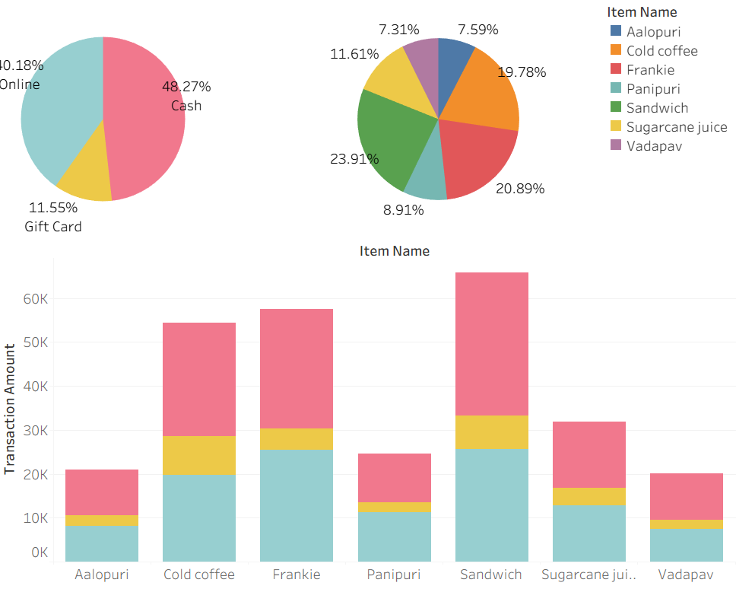
Understanding What Customers Buy and How They Pay
Insights:
Sandwiches are the top-selling item, dominating total purchases.
Cash is still the most common payment method, but online payments are rising, especially for higher-priced items.

Slide 8
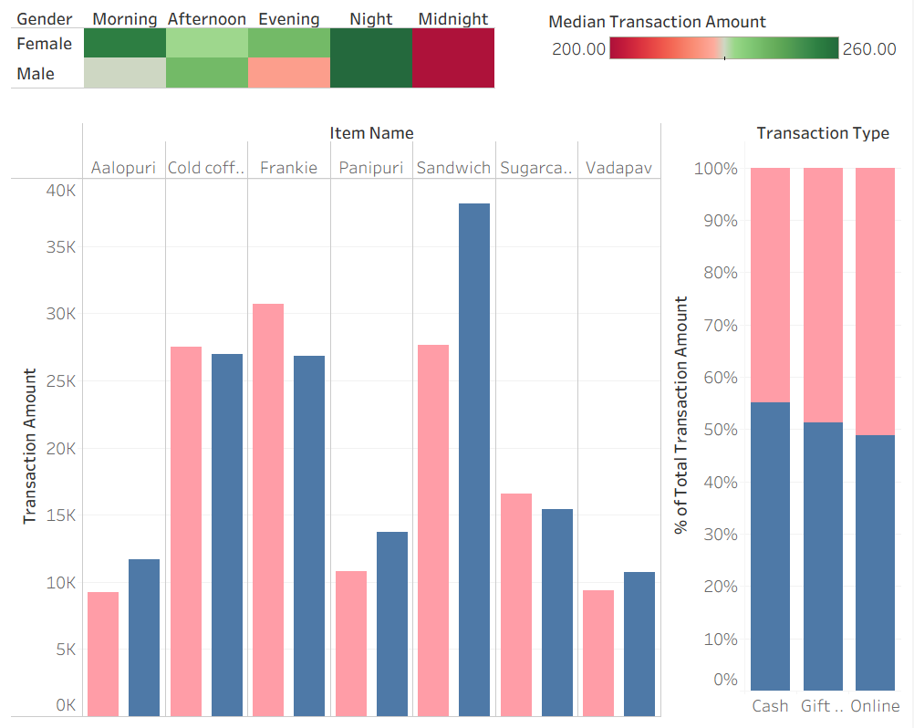
How Gender Influences Purchase Behavior
Insights:
Female customers spend more during evening and night hours, suggesting a prime window for targeted deals.
Item preferences differ: women lean towards Frankies and Cold Coffees while men purchase more Sandwiches.
Payment behavior varies slightly: females tend to use online payment more often, while males rely more on cash.

Slide 9
Recommendations
1. Reevaluate Tuesday Operations
The most amount of spending happens at night while conversely the least amount happens at midnight, this may be because store is closing so customers don’t have a chance to buy even if they’d like to.
Recommendation: Extend hours on weekends to 1–2 AM to capture more high-spend customers.
2. Reevaluate Tuesday Operations
Friday consistently shows the lowest customer traffic and revenue.
Recommendation: Consider closing on Friday or running targeted “Slow Day” promotions to reduce operational losses.
3. Promote High-Performing Menu Items More Aggressively
Sandwiches and beverages account for a large share of total sales.
Recommendation: Create bundles (e.g., sandwich + drink) or loyalty points to increase average spend.
4. Target Nighttime Shoppers with Upsells
Night transactions show higher baskets and more variety.
Recommendation: Add nighttime specials, snack bundles, or suggestion-based add-ons (like fries or dessert).

Slide 10
Recommendations (cont.)
5. Build Gender-Specific Marketing Campaigns
Customer patterns differ by gender: women buy more items like Cold Coffees; men buy more Sandwiches.
Recommendation:
Promote female-preferred items on social media platforms with high female user bases as females contribute more to online orders.
Showcase in-store promos that target foods that are bought predominately by males such as Sandwiches, Vadapav, and Aalopuri.
6. Introduce a Lunch-Hour Deal
Revenue dips significantly around noon.
Recommendation: Add a mid-day promotion (“Lunch Combo”, “Buy 1 Get 1 50% Off”) to increase traffic during slow hours.

Slide 11
Next Steps
1. Explore Profit in More Detail
If more information on costs (ingredients, labor, rent) were available, I could calculate true profit instead of assuming a 30% operating cost.
2. Analyze More Customer Demographics
If I had extra data such as age, income level, or visit frequency, I could see which groups spend the most and tailor recommendations more specifically.
3. Improve Data Quality
If raw data included exact order details (like customizable toppings, extra items, or discounts), I could perform deeper EDA and more accurate forecasting.
4. Build a Simple Forecast
With more historical data, I could predict next month’s sales or busiest days using a small time-series model.

